Slide 1
Undecidability
Reading: Chapter 8 & 9

Slide 2
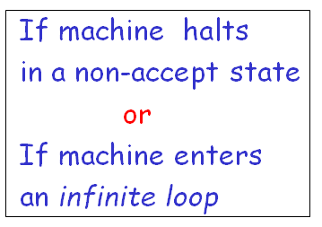
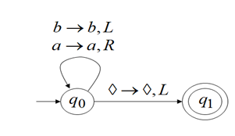
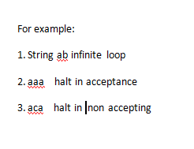
Infinite loop

Slide 3
Decidability vs. Undecidability
There are two types of TMs (based on halting):
(Recursive)
TMs that always halt, no matter accepting or non-accepting ≡ DECIDABLE PROBLEMS
(Recursively enumerable)
TMs that are guaranteed to halt only on acceptance. If non-accepting, it may or may not halt (i.e., could loop forever).
Undecidability:
Undecidable problems are those that are not recursive

Slide 4
Recursive, RE, Undecidable languages
No TMs exist
TMs that always halt
LBA
Non-RE Languages (all other languages for which no TMs can be built)
TMs that may or may not halt
Context- free
(PDA)
Regular
(DFA)
Recursively Enumerable (RE)
Context
sensitive
Recursive
“Undecidable” problems
“Decidable” problems

Slide 5
Recursive Languages & Recursively Enumerable (RE) languages
Any TM for a Recursive language is going to look like this:
Any TM for a Recursively Enumerable (RE) language is going to look like this:
M
“accept”
w
“reject”
M
“accept”
w

Slide 6
Closure Properties of: - the Recursive language class, and - the Recursively Enumerable language class

Slide 7
Recursive Languages are closed under complementation
If L is Recursive, L is also Recursive
M
M
“accept”
“accept”
w
w
“reject”
“reject”

Slide 8
Are Recursively Enumerable Languages closed under complementation? (NO)
If L is RE, L need not be RE
M
M
“accept”
“accept”
?
w
w
?
“reject”

Slide 9
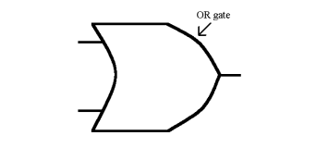
Recursive Langs are closed under Union
Let M_{u} = TM for L₁ U L₂
M_{u} construction:
Make 2-tapes and copy input w on both tapes
Simulate M₁ on tape 1
Simulate M₂ on tape 2
If either M₁ or M₂ accepts, then M_{u} accepts
Otherwise, M_{u} rejects.
M_{u}
M₁
accept
reject
OR
w
M₂
accept
reject

Slide 10

Recursive Langs are closed under Intersection
Let M_{n} = TM for L₁ ∩ L₂
M_{n} construction:
Make 2-tapes and copy input w on both tapes
Simulate M₁ on tape 1
Simulate M₂ on tape 2
If M₁ AND M₂ accepts, then M_{n} accepts
Otherwise, M_{n} rejects.
M_{n}
M₁
accept
reject
AND
AND
w
M₂
accept
reject

Slide 11
Other Closure Property Results
Recursive languages are also closed under:
Concatenation
Kleene closure (star operator)
Homomorphism, and inverse homomorphism
RE languages are closed under:
Union, intersection, concatenation, Kleene closure
RE languages are not closed under:
complementation

Slide 12
“Languages” vs. “Problems”
A “language” is a set of strings
Any “problem” can be expressed as a set of all strings that are of the form:
“<input, output>”
==> Every problem also corresponds to a language!!
e.g., Problem (a+b) ≡ Language of strings of the form { “a#b, a+b” }
Think of the language for a “problem” == a verifier for the problem

Slide 13
The Halting Problem
An example of a recursive enumerable problem that is also undecidable

Slide 14
The Halting Problem
Non-RE Languages
Context- free
(PDA)
Regular
(DFA)
x
Recursively Enumerable (RE)
Context
sensitive
Recursive

Slide 15
What is the Halting Problem?
Definition of the “halting problem”:
Does a givenTuring Machine M halt on a given input w?
Machine
M
Input w

Slide 16
The Universal Turing Machine
A Turing Machine simulator
Given: TM M & its input w
Aim: Build another TM called “H”, that will output:
“accept” if M accepts w, and
“reject” otherwise
An algorithm for H:
Simulate M on w
H(<M,w>) =
Implies: H is in RE
accept, if M accepts w
reject, if M does does not accept w
Question: If M does not halt on w, what will happen to H?

Slide 17
A Claim
Claim: No H that is always guaranteed to halt, can exist!
Proof: (Alan Turing, 1936)
By contradiction, let us assume H exists
H
“accept”
<M,w>
“reject”

Slide 18
HP Proof (step 1)
Therefore, if H exists ➔ D also should exist.
But can such a D exist? (if not, then H also cannot exist)
Let us construct a new TM D using H as a subroutine:
On input <M>:
Run H on input <M, <M> >; //(i.e., run M on M itself)
Output the opposite of what H outputs;
D
H
“accept”
“accept”
<M>
<M, “<M>” >
“reject”
“reject”

Slide 19
HP Proof (step 2)
The notion of inputing “<M>” to M itself
A program can be input to itself (e.g., a compiler is a program that takes any program as input)
accept, if M does not accept <M>
reject, if M accepts <M>
D (<M>) =
Now, what happens if D is input to itself?
accept, if D does not accept <D>
reject, if D accepts <D>
D (<D>) =
A contradiction!!! ==> Neither D nor H can exist.

Slide 20
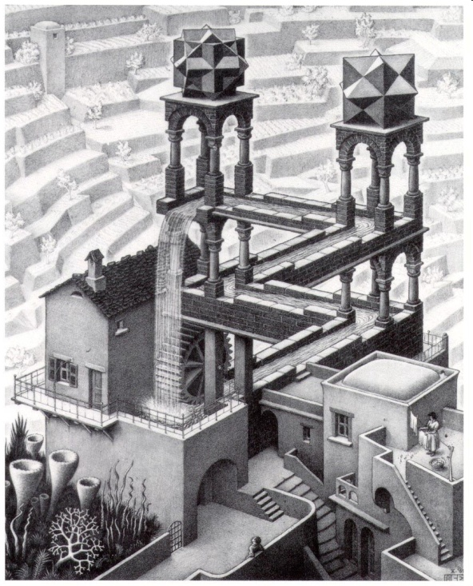

Of Paradoxes & Strange Loops
E.g., Barber’s paradox, Achilles & the Tortoise (Zeno’s paradox) MC Escher’s paintings
A fun book for further reading:
“Godel, Escher, Bach: An Eternal Golden Braid” by Douglas Hofstadter (Pulitzer winner, 1980)

Slide 21
The Diagonalization Language
Example of a language that is not recursive enumerable
(i.e, no TMs exist)

Slide 22
The Diagonalization language
The Halting Problem
Non-RE Languages
x
Context- free
(PDA)
x
Regular
(DFA)
Recursively Enumerable (RE)
Context
sensitive
Recursive

Slide 23
A Language about TMs & acceptance
Let L be the language of all strings <M,w> s.t.:
M is a TM (coded in binary) with input alphabet also binary
w is a binary string
M accepts input w.

Slide 24
Enumerating all binary strings
Let w be a binary string
Then 1w ≡ i, where i is some integer
E.g., If w=ε, then i=1;
If w=0, then i=2;
If w=1, then i=3; so on…
If 1w≡ i, then call w as the i^{th} word or i^{th} binary string, denoted by w_{i}.
==> A canonical ordering of all binary strings:
{ε, 0, 1, 00, 01, 10, 11, 000, 100, 101, 110, …..}
{w₁, w₂, w₃, w₄, …. w_{i}, … }

Slide 25
Any TM M can also be binary-coded
M = { Q, {0,1}, Γ, δ, q₀,B,F }
Map all states, tape symbols and transitions to integers (==>binary strings)
δ(q_{i},X_{j}) = (q_{k},X_{l},D_{m}) will be represented as:
==> 0^{i}1 0^{j}1 0^{k}1 0^{l}1 0^{m}
Result: Each TM can be written down as a long binary string
==> Canonical ordering of TMs:
{M₁, M₂, M₃, M₄, …. M_{i}, … }

Slide 26
The Diagonalization Language
L_{d} = { w_{i} | w_{i} ∉ L(M_{i}) }
The language of all strings whose corresponding machine does not accept itself (i.e., its own code)
(input word w)
j
 | 1 | 2 | 3 | 4 | …
1 | 0 | 1 | 0 | 1 | …
2 | 1 | 1 | 0 | 0 | …
3 | 0 | 1 | 0 | 1 | …
4 | 1 | 0 | 0 | 1 | …
Table: T[i,j] = 1, if M_{i} accepts w_{j} = 0, otherwise.
(TMs)
i
Make a new language called L_{d} = {w_{i} | T[i,i] = 0}
.
.
…
.
diagonal

Slide 27
L_{d} is not RE (i.e., has no TM)
Proof (by contradiction):
Let M be the TM for L_{d}
==> M has to be equal to some M_{k} s.t. L(M_{k}) = L_{d}
==> Will w_{k} belong to L(M_{k}) or not?
If w_{k} ∈ L(M_{k}) ==> T[k,k]=1 ==> w_{k}∉ L_{d}
If w_{k} ∉ L(M_{k}) ==> T[k,k]=0 ==> w_{k} ∈ L_{d}
A contradiction either way!!

Slide 28
Why should there be languages that do not have TMs?
We thought TMs can solve everything!!

Slide 29
Non-RE languages
How come there are languages here?
(e.g., diagonalization language)
Non-RE Languages
Context- free
(PDA)
Regular
(DFA)
Recursively Enumerable (RE)
Context
sensitive
Recursive

Slide 30
One Explanation
There are more languages than TMs
By pigeon hole principle:
==> some languages cannot have TMs
But how do we show this?
Need a way to “count & compare” two infinite sets (languages and TMs)

Slide 31
How to count elements in a set?
Let A be a set:
If A is finite ==> counting is trivial
If A is infinite ==> how do we count?
And, how do we compare two infinite sets by their size?

Slide 32
Cantor’s definition of set “size” for infinite sets (1873 A.D.)
Let N = {1,2,3,…} (all natural numbers)
Let E = {2,4,6,…} (all even numbers)
Q) Which is bigger?
A) Both sets are of the same size
“Countably infinite”
Proof: Show by one-to-one, onto set correspondence from N ==> E
n
1
2
3
.
.
.
f(n)
2
4
6
.
.
.
i.e, for every element in N, there is a unique element in E, and vice versa.

Slide 33
Example #2
Let Q be the set of all rational numbers
Q = { m/n | for all m,n ∈ N }
Claim: Q is also countably infinite; => |Q|=|N|
1/1
1/2
1/3
1/4
1/5
….
2/1
2/2
2/3
2/4
2/5
….
….
3/1
3/2
3/3
3/4
3/5
4/4
4/5
….
4/1
4/2
4/3
5/1
5/2
….

Slide 34
Uncountable sets
Really, really big sets!
(even bigger than countably infinite sets)
Example:
Let R be the set of all real numbers
Claim: R is uncountable
n
1
2
3
4
.
.
.
f(n)
3 . 1 4 1 5 9 …
5 . 5 5 5 5 5 …
0 . 1 2 3 4 5 …
0 . 5 1 4 3 0 …
Build x s.t. x cannot possibly occur in the table
E.g. x = 0 . 2 6 4 4 …

Slide 35
Therefore, some languages cannot have TMs…
The set of all TMs is countably infinite
The set of all Languages is uncountable
==> There should be some languages without TMs ( by PHP)

Slide 36
The problem reduction technique, and reusing other constructions

Slide 37
Languages that we know about
Language of a Universal TM (“UTM”)
L_{u} = { <M,w> | M accepts w }
Result: L_{u} is in RE but not recursive
Diagonalization language
L_{d} = { w_{i} | M_{i} does not accept w_{i} }
Result: L_{d} is non-RE

Slide 38
TMs that accept non-empty languages
L_{ne} = { M | L(M) ≠ ∅ }
L_{ne} is RE
Proof: (build a TM for L_{ne} using UTM)
Non-deterministic Simulator for L_{ne}
UTM
“accept”
“accept”
M
M
Guess w

Slide 39
TMs that accept non-empty languages
L_{ne} is not recursive
Proof: (“Reduce” L_{u} to L_{ne})
Idea: M accepts w if and only if L(M’) ≠ ∅
L_{u}
M_{ne}
“accept”
“accept”
L_{ne}
<M,w>
M’
Transformation
function

Slide 40
Reducability
To prove: Problem P₁ is undecidable
Given/known: Problem P₂ is undecidable
Reduction idea:
“Reduce” P₂ to P₁:
Convert P₂’s input instance to P₁’s input instance s.t.
P₂ decides only if P₁ decides
Therefore, P₂ is decidable
A contradiction
Therefore, P₁ has to be undecidable

Slide 41
The Reduction Technique
Note:
not same as
P₁ ==> P₂
Reduce P₂ to P₁:
Construct
P₂
instance
P₁
instance
Decide
yes
no
Conclusion: If we could solve P₁, then we can solve P₂ as well

Slide 42
Summary
Problems vs. languages
Decidability
Recursive
Undecidability
Recursively Enumerable
Not RE
Examples of languages
The diagonalization technique
Reducability

